Slide 1

Mini Project-1 ORGAN DONATION SYSTEM Department of Information Technology B.E. III SEM- AI&DS
Pasunuri Kathyayini - 160121771088

Slide 2
Contents
Introduction
Background
Motivation
Problem Statement
System Design
Software Requirements
Implementation &Results
Conclusion & Future Work
References

Slide 3
INTRODUCTION
Organ donation refers to the donation of biological tissue or an organ of the human body, from a living or dead person to a living recipient in need of a transplant.
By donating organs, we can give someone a second chance at life and help them overcome their health challenges.
Organ donation is not seriously encouraged and taken by everyone as this concept revolves around many myths and superstitions.
As a result, many people die as an organ is not provided to them when needed.
These need to be removed by spreading awareness and making organ donation accessible for everyone

Slide 4
BACKGROUND
There are many organ donation websites available that focus mainly on spreading awareness on organ donation and making people pledge on being donors after they die.
These websites focus on bringing more donations to the people but do not provide the details of organs received or make them available for recipients to see and request the suitable one for them instead of having them on waiting list
The website that manages all organ donations in India is NOTTO(National Organ and Tissue Transplant Organisation).

Slide 5

MOTIVATION
Organ donation is a selfless act that can transform the lives of people who are in desperate need of an organ transplant.
Often, it becomes difficult for a patient to find the required donor at needed times. The contact between the donor and patient is the demand of the hour and requires a solution. Even if the donor is found, it becomes hard for the transportation of the organ within the prescribed time period and finding a suitable medical team to operate on them is also a dramatic problem.

Slide 6
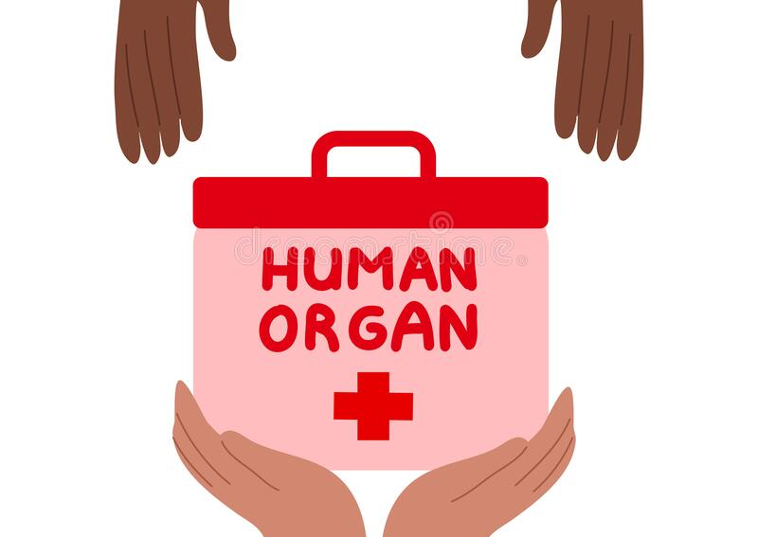
PROBLEM STATEMENT
To create a system that serves as a one-stop-solution to all organ-donation queries and problems which makes the contact between doctors/patients who need organs and donors easy, transparent, and whenever needed.

Slide 7
SYSTEM DESIGN
In this proposed system of Organ Donation, in addition to spreading awareness on Organ Donation, solving queries, and making people pledge to be organ donors, there is a provision for the dead people to register as donors which will be displayed on the site with all the contact details. The patients/doctors in urgent need of organs can search for the required organ, the blood group and from nearest available location.
The tools required to make this web-based platform are a text editor, web server, a web browser and HTML, CSS, Boootstrap for frontend, PHP for functionality and MySQL to store and manage databases.

Slide 8
SOFTWARE AND HARDWARE REQUIREMENTS
Visual Studio Code: Visual Studio Code, commonly referred to as Visual Code or just VSCode, is a free and open-source code editor developed by Microsoft. Visual Studio Code is designed to be highly customizable and extensible, making it an ideal tool for a wide range of programming tasks, from writing simple scripts to developing complex applications.
XAMPP: XAMPP is an open-source software package that provides a complete web development environment. XAMPP stands for Cross-Platform (X), Apache (A), MariaDB (M), PHP (P), and Perl (P).
Desktop/Laptop: A basic operation system of Windows/Linux/MacOs with least requirements like 4GB RAM and 64GB storage which has access to a internet access and modern web browser.
Languages used: HTML, CSS, PHP, MySQL

Slide 9
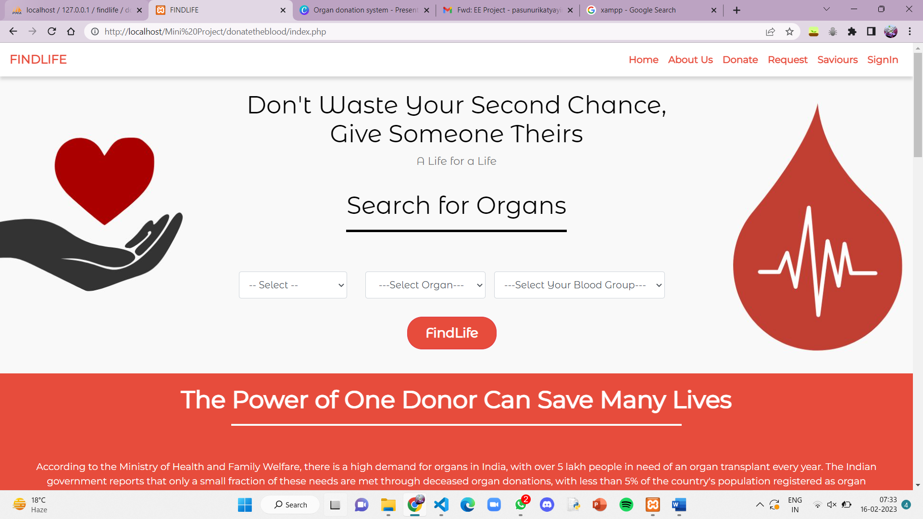
IMPLEMENTATION & RESULTS
The initial page(Homepage) of the website FINDLIFE, gives awareness and encourages people to donate organs. There are also a few common FAQs solved and the main intention and focus of the platform is clearly mentioned for the user

Slide 10
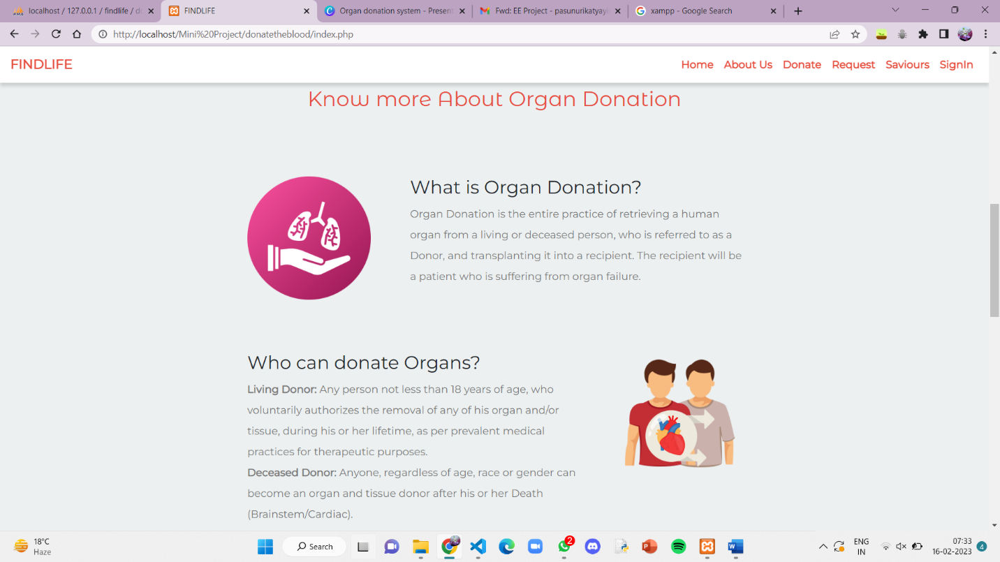
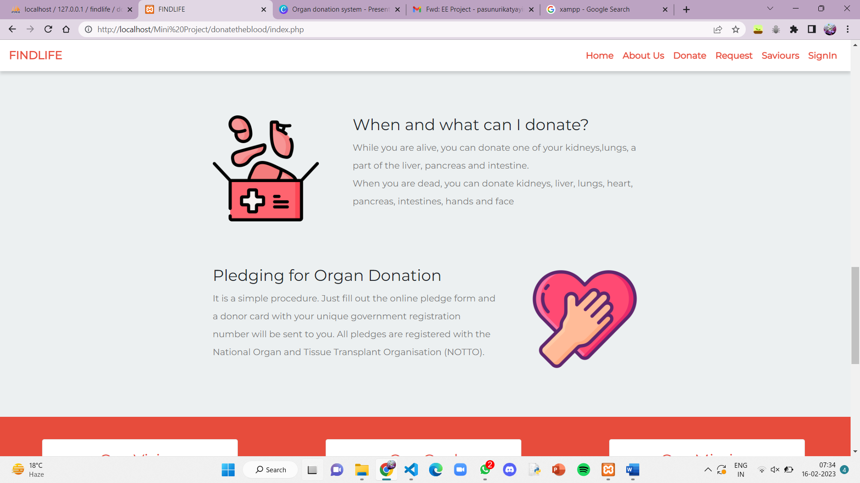
IMPLEMENTATION(Contd.)

Slide 11
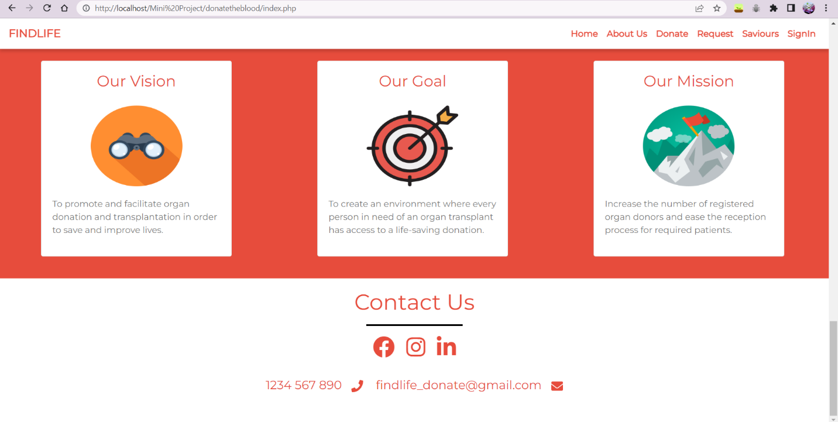
IMPLEMENTATION & RESULTS(Contd.)
The about page tells about the vision, mission and goals of creating FindLife

Slide 12
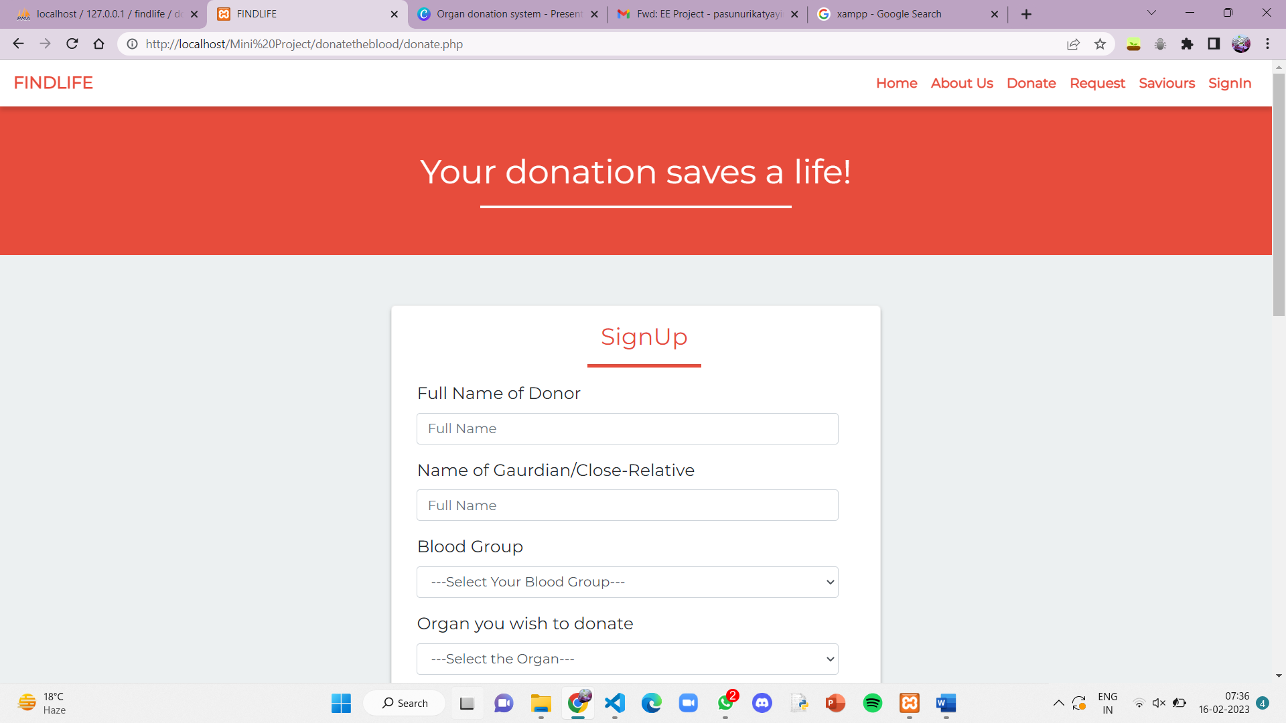
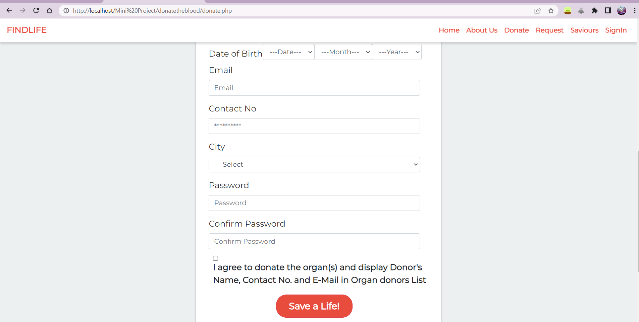
IMPLEMENTATION & RESULTS(Contd.)
Donate page gives a form to be filled by Guardian/Close-relative of donor when he is dead

Slide 13
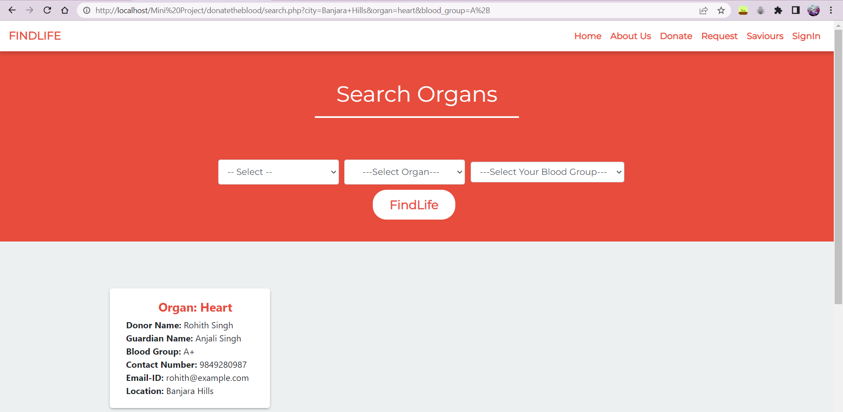
IMPLEMENTATION & RESULTS(Contd.)
Request page gives details of required donors for the search inputs of city, organ and blood group

Slide 14
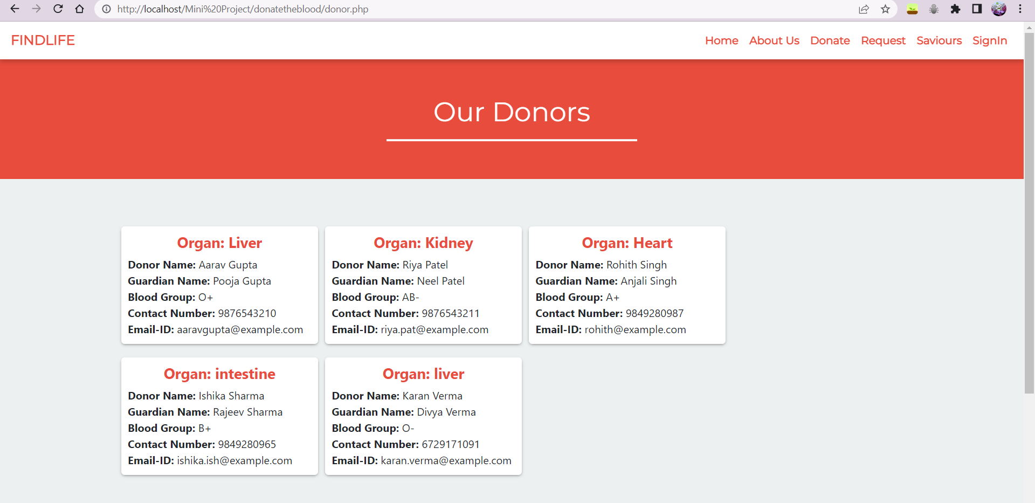
IMPLEMENTATION(Contd.)
Saviours page gives details all the donors who donated organs through FindLife.

Slide 15
IMPLEMENTATION & RESULTS(Contd.)
Saviours page gives details all the donors who donated organs through FindLife.

Slide 16
CONCLUSION
The organ donation website “FindLife” is created which reached the two goals set at first, spreading awareness on organ donation and maintaining proper contact between donors and recipients so that no person dies of lack of supply of organs.
The website also assures safety and security for the details provided by the users and makes efficient use of them by displaying it directly to the recipients and enabling them to request.
Recipient can apply filters like city, organ and blood group to see the available options and choose the suitable one.

Slide 17
FUTURE SCOPE
AI & ML technologies can be used to increase efficiency, algorithms can match donors and recipients quickly and accurately
It can be used as a platform for research and analysis.
Recipients can directly click on a button to request for the organ and the suitable organ is delivered to their place at the required time whenever needed.
It can provide a portal for living donors too to come forward and donate organs for the needy.
Impact of the website can be expanded through partnerships and collaborations.

Slide 18
REFERENCES
Organ Donation Websites:
www.notto.nic.in
www.organdonor.gov
www.organindia.org
www.mohanfoundation.org
Web development tools:
www.getbootstrap.com
www.fontawesome.com
https://www.phpmyadmin.net/docs/
https://en.wikipedia.org/wiki/PHP

Slide 19
THANK YOU

